Slide 1
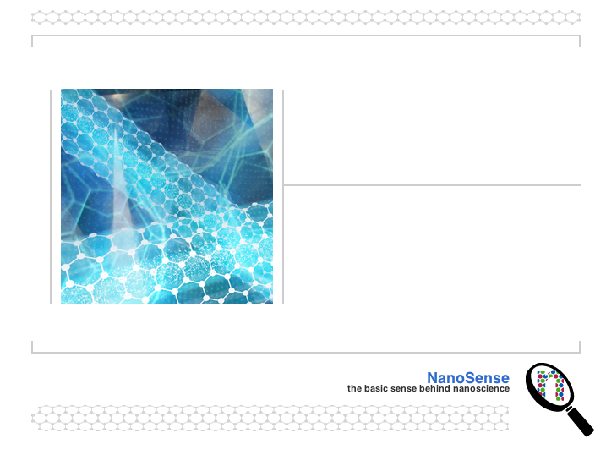
The Science of Water
We are surrounded by water; we are made of water

Slide 2
Water in our World
Water is necessary for life
Water in our atmosphere helps to keep the planet warm
Our bodies are composed of and dependent on water

Slide 3
A Quick Overview
What are some of the properties of water that make it so essential to life on our planet?

Slide 4
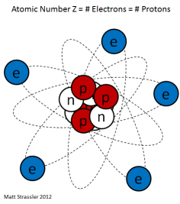
All Matter is Composed of Atoms
The atom is composed of
  A nucleus made of neutrons and protons
  An electron “cloud” composed of electrons
Protons and neutrons have nearly identical masses, but their charge is different
  Protons are a positive (+) electrical charge and neutrons do not have an electrical charge

Slide 5
Subatomic Particles Composing the Atom
Subatomic Particle | Charge | Size | Location
Proton | +1 | 1 | Part of the nucleus
Neutron | 0 | 1 | Part of the nucleus
Electron | -1 | 0 | Electron “cloud” (outside of the nucleus)

Slide 6
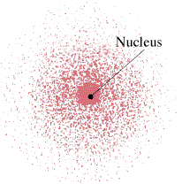
The Quantum Atom
We can only describe areas of probability where we might find an electron
  Electrons are constantly moving
  Electrons have a specific amount of (quantum) of energy, related to their position from the nucleus

Slide 7
Question
Why do we care about what atoms are made of?

Slide 8
Electric Charge
- Electric charge is a basic force that causes movement

Slide 9
Net Charge of an Atom or Ion
The charge on any substance is a result of the total number (#) of
  Protons (p) + charges, nucleus, and
  Electrons (e-) - charges, outside the nucleus
If the # of…. Then the net charge is….
  p=e- neutral (atom)
  p>e- positive (ion)
  e->p negative (ion)

Slide 10
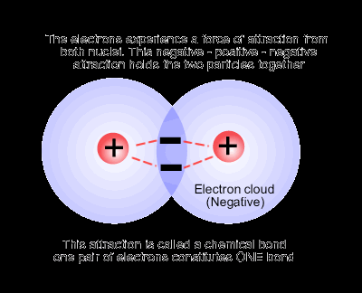
Atoms Bond
The outer electrons of both atoms are mutually attracted to the nuclei
  Oppositely charged particles form a bond, representing a lower energy state for each of the atoms, releasing energy

Slide 11
Why are Bonds Formed?
Bonds are formed because of the electrostatic attraction between atoms.
In doing so, the atoms achieve a lower energy state.

Slide 12
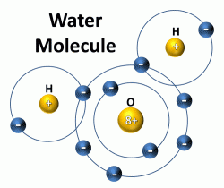
Forming a Water Molecule
Unequal attraction to bonding electrons
  Oxygen is a strong electron grabber (high electronegativity)
  Hydrogen’s electron cloud tends to hang out close to oxygen, leaving H’s positively charge nucleus all by itself

Slide 13
Electron Density is Uneven
The average electron density around the oxygen atom in a water molecule is about 10 times greater than the density around the hydrogen atoms
  This non-uniform distribution of positive and negative charges, called a dipole, leads to the substance’s unusual behavior

Slide 14
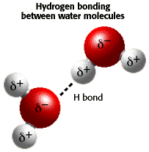
Water is a Polar Molecule
The unequal distribution of charges on the water molecule make it a polar molecule
  One end is more negative, and one end is more positive

Slide 15
Hydrogen Bonding I
The partial negative end of the oxygen atom is attracted to the partial positive end of the H atom on an adjacent molecule
Hydrogen bonds give water its unique properties

Slide 16
Hydrogen Bonding II
http://www.northland.cc.mn.us/biology/Biology1111/animations/hydrogenbonds.html

Slide 17
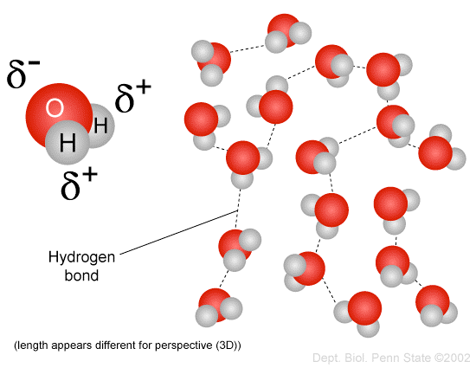
Hydrogen Bonding Representation
In water, hydrogen bonds form between the partially negatively charged oxygen atom and the partially positively charged hydrogen atom

Slide 18
Unique Properties of Water
Universal solvent
Exists in nature as a solid, liquid, and gas
The density of ice is less than liquid water
High surface tension
High heat capacity
Exists as a liquid at room temperature

Slide 19
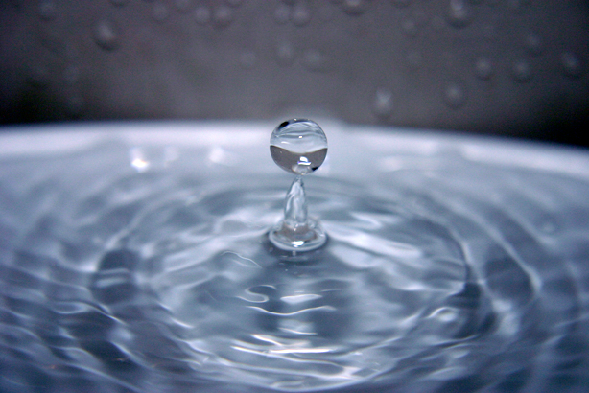
High Surface Tension
Allows water to form drops
Allows water to form waves
Water drops can “adhere” to surfaces even though gravity is pulling on them

Slide 20

Can You Explain Why this Drop Sticks to the Leaf and Grows Larger?

Slide 21
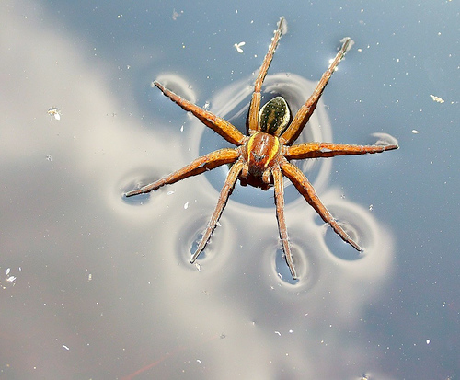
Or How this Spider Can Walk on Water?

Slide 22
Adhesion
Adhesive forces are attractive forces that occur between two unlike substances
In a narrow glass tube
  Water molecules are more strongly attracted to the tube than they are to each other (cohesion)
  The cup shape formed at the top of the water is called a meniscus

Slide 23
High Specific Heat Keeps Beaches Cooler in the Day and Warmer at Night
Specific heat
  The amount of energy required to change 1 gram of a substance 1 degrees Celsius
Water has high specific heat
  Absorbs large amounts of heat energy before it begins to get hot
  Releases heat energy slowly
  Moderates the Earth’s climate and helps living organisms regulate their body temperature

Slide 24
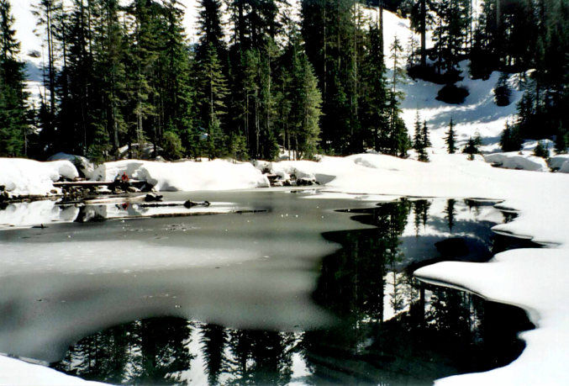
Solid, Liquid, Gas
Water is the only substance which exists under normal conditions on earth as a solid, a liquid, and a gas

Slide 25
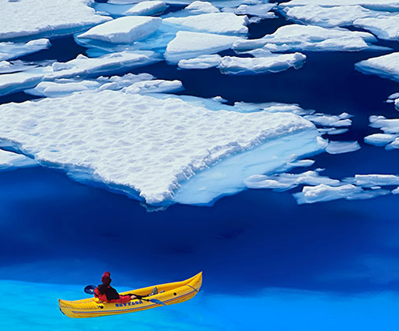
Ice is Less Dense than Water I
Temperature ◦C | Density g/cm3
0 (solid) | 0.9150
0 (liquid) | 0.9999
4 | 1.0000
20 | 0.9982
100 (gas) | 0.0006

Slide 26
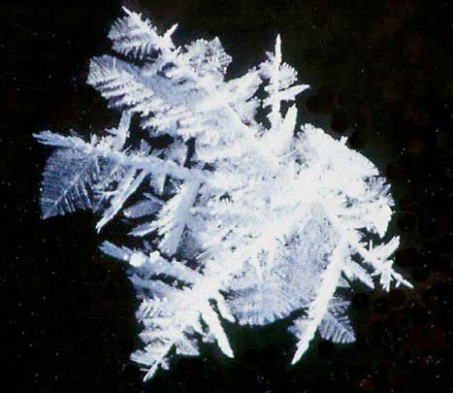
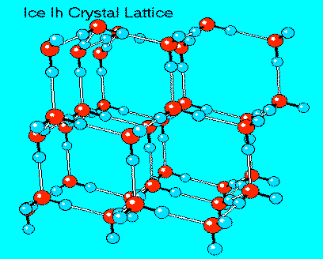
Ice is Less Dense than Water II
This is a very rare property!

Slide 27
Questions
Can you imagine if ice did not float?
How do you think that would affect the world?

Slide 28
Water is a Universal Solvent
Water is a polar molecule with one end more positive and one end more negative
  Being polar allows water to dissolve nearly any substance with an unequal distribution of charges
  Water is the best substance that is universally used for transporting dissolved substances

Slide 29
Important Points
What are water’s unique properties?
What is water’s structure, and how does it cause these properties?
What would our world or life be like without water?

